Slide 1
BRANCH OFFICE INSPECTIONS
Maximizing Value From Your Branch Office Exams During Covid-19 and Beyond: A Hands-on Perspective

Slide 2
Presenters
Sander J. Ressler
Managing Director
Essential Edge Compliance Outsourcing Services, LLC
Spenser Rubin
Senior Product Manager
RegEd, Inc.

Slide 3
Branch Office Inspections
Sander J. Ressler
303-594-8237 | sander@eefirms.com
Maximizing Value in your Branch Office Inspections

Slide 4
Internal Inspections
FINRA Rule 3110

Slide 5
Internal Inspections: FINRA Rule 3110
Conduct a review, at least annually (on a calendar-year basis). The inspections shall:
be reasonably designed to assist the member in detecting and preventing violations of, and achieving compliance with, applicable securities laws and regulations, and with applicable FINRA rules;
inspect activities of each office, including the periodic examination of customer accounts to detect and prevent irregularities or abuses;
retain a written record of the date upon which each review and inspection is conducted.

Slide 6
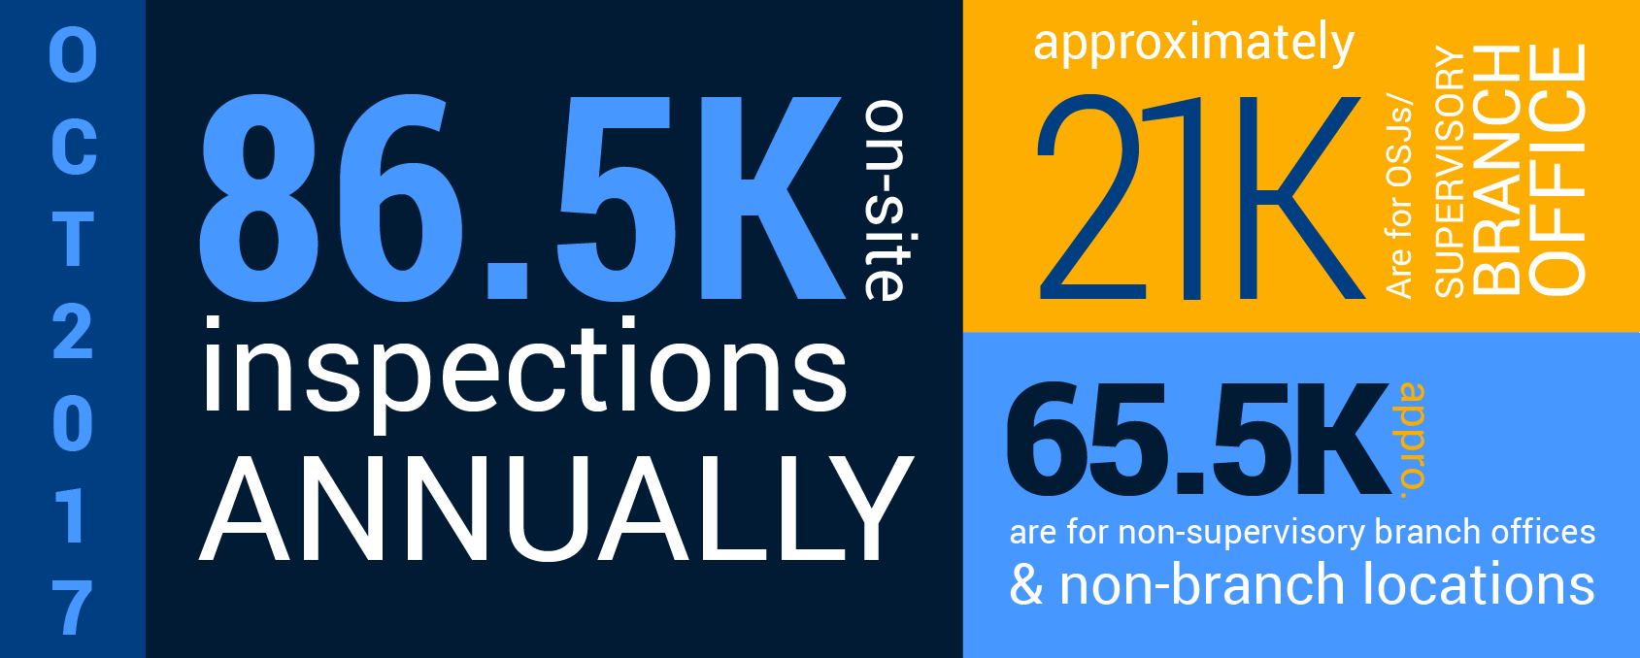
Internal Inspections
OSJs
SUPERVISORY
BRANCH
OFFICE
approx.
Source: FINRA
Based on data available as of October 2017, firms conduct approximately 86,500 on-site inspections annually, of which approximately 21,000 are for OSJs or supervisory branch offices and approximately 65,500 are for non-supervisory branch offices and non-branch locations.
Note: This excludes offices of convenience, which should be reviewed periodically.

Slide 7
Background of Branch Inspections
Historical Context

Slide 8
Background of Branch Inspections
Branch Inspections: Historical Context
After the introduction of IBDs to the industry in the early 1980s, the requirement for conducting branch inspections was important because RRs had the ability to send funds and applications directly to mutual fund and variable annuity issuers without sending paperwork to the home office for supervision and record keeping. In many ways, branch inspections were the only windows into the conduct of a RR.
In the past 10 years, imaging workflow has eliminated the issue of applications being submitted directly to product issuers. Firms now see all transactions conducted by their RRs.

Slide 9
Background of Branch Inspections
What are we looking for in today’s branch inspections?
What do these issues all have in common? They will not be detected in a remote inspection.
Selling away
Pre-signed forms
Improper relationships
Undisclosed Outside Business Activities
Ineffective cybersecurity
Client privacy issues (electronic and hard copies must be secure)

Slide 10
Background of Branch Inspections
Inspection Cost Limitations
Salaried Employees
Travel Time
Supervision Cost
Accounting Cost
Follow Up
Training
How do you conduct a thorough inspection in the face of these costs?
Inspection Cost Limitations:
Salaried employees
Travel time
Supervision costs
Accounting costs
Follow-up
How do you conduct a thorough inspection in the face of these costs?

Slide 11
Preparation
How do you prepare?

Slide 12
Preparation: by the Home Office
The following should be made available to reviewer prior to the inspection:
Occupants of the branch office
Product mix of the RRs in the office
Commissions earned over the past 12 months
Summary of customer complaints since last inspection
Deficiency letters from prior inspections

Slide 13
Preparation: by Examiner
The following should be performed by the reviewer prior to the inspection:
Internet Search
Email search for OBAs and keywords
Google name of all branch personnel, all DBAs and all disclosed OBAs
Search Facebook, Twitter, LinkedIn and Instagram
Search branch website, if any

Slide 14
Preparation: Schedule an Inspection
An inspection should take 2-3 hours for a branch office with 1-2 RRs
Do not schedule more than 2-3 branch inspections in a day
Schedule 2-3 weeks in advance for announced inspection
All PICs and RRs should be present to answer questions during the inspection

Slide 15
Preparation: Conducting the Inspection
Who should conduct the inspection?
Experience vs. inexperience: Send an examiner with experience who possesses at least a Series 7
Sending an OSJ or his/her delegate to conduct an inspection provides little protection; they have little/no training and they have a conflict of interest
Do not have the same examiner inspect an office 3 years in a row

Slide 16
Getting Started
All you need to know

Slide 17
Getting Started: The Inspection
Photos of the building directory
Photos of door
Photos of SIPC and BD signage
Photos of the internal office structure and layout
Photos of external signage, if any

Slide 18
Getting Started: The Questionnaire
Stop asking “airline” questions; save them for the ACQ
Stop looking at random customer files and reviewing transactions – what do you expect to find?
Review customer files for pre-signed forms
Open every drawer and office doors
Get details on office sharing, if any
Be aware of sharing mailboxes and/or office addresses
Verify that all computers are secure
Verify that WiFi is secure
Verify that anti-virus software is up-to-date
Copy of IT contract, as applicable; review for confidentiality clause
Verify "clean desk" policy (i.e., cleaning crew access may be an issue)

Slide 19
Getting Started: Workpapers
Business cards, letterhead and fax cover sheet
Personal e-mail (or any email not captured by BD)
OBA 1099s
IT vendor contracts
Bank statements
Client notes thru CRM
Business continuity plan
Evidence of deposits of more than $1,000 when the funding source is not clear
OSJs: Signature Guarantee Log and RR files
Brokercheck (detailed report)
IARs: ADV Part 2B
Check, transaction and gift logs
Independent RIAs: Advisory service agreements
Office sharing agreements, if any
Recommended: Credit Reports
Cyber security: How are computers protected?
Anti-viral software
- +
Business cards, letterhead and fax cover sheet
Credit report
Bank statements
Brokercheck
Cyber security
(detailed report)
Recommended credit report
Personal e-mail
IT vendor contracts
Client notes thru CRM

Slide 20
Ongoing Impacts of Covid-19 on Branch Inspections

Slide 21
FINRA Approves Remote Inspections
FINRA recently issued a new rule (2020-040) to allow remote inspections for 2020 and 2021.
PROS
CONS
Better Staffing Allocation
Cost Savings Due to Lack of Travel
No Unannounced Visits
Increased Risk Exposure to the BD
RRs Know You’re Not Visiting
Increased Potential of Selling Away or Other Violations
Accelerated schedule beyond 2021? Do you want to wait 5-6 years to be on-site?

Slide 22
Changes in the Wake of Covid-19
Have you revised your WSPs to reflect remote reviews in 2020/2021?
Should you request photos or video footage?
Are you modifying your heightened supervision plans?
Are your workpapers being securely transmitted?
Are you modifying your questionnaire to reflect the exclusion of on-site visits?

Slide 23
Do Remote Reviews Cut Costs?
Heightened supervision plans in 2021?
Accelerated number of reviews in 2022?
Accelerated percentage of unannounced visits in 2022?
Risk-based schedule?

Slide 24
THANK YOU.
Sander J. Ressler 303-594-8237 | sander@eefirms.com
Beth C. Barak 646-981-8034 | beth@eefirms.com

Slide 25
RegEd Branch Audit Management
Solution Overview

Slide 26
Enterprise Audit Management
RegEd’s Enterprise Audit Management Solution
The industry-leading solution that systematizes end-to-end management of a firms’ branch supervisory and inspection program, from planning to execution and reporting, using advanced automation tools and configurable workflows.

Slide 27
Enterprise Audit Management
Typical Branch Audit Workflow:
Pre-Work
Scheduling & Prep
Day-of
Survey, Inspect, Collect
Post-Work
Findings & Reports

Slide 28
Enterprise Audit Management
Pre-Work | Scheduling & Preparation
Flexible audit cycles – plan by branch type, location, or exam content
Audit planning assistant – show upcoming and “overdue” audits
Convert audit plans to scheduled events, triggering automated emails and opening exam content to auditors.
Reschedule, reassign, and update audits at any time. Schedule an ad-hoc or for-cause audit without impacting planned audits.
Distribute pre-audit questionnaires ahead of audits to reduce time spent on-site or in-person.
Pre-Work
Day-of
Post-Work

Slide 29
Enterprise Audit Management
Day-of | Survey, Inspect, Collect
Pre-audit content may be analyzed ahead of audits to allow for necessary adjustments and effectively reduce audit cycle times
Conduct audits from anywhere – use a live connection to the internet or download content for offline/remote use.
Preview findings as you work. Instantly calculate deficiencies and rapidly generate automated close-out letters.
Configurable workflows allow for intelligent routing based on pre-defined business processes.
Questionnaire
Pre-Audit Questionnaire
Office Type:
Branch Type:
Document Delivery Log:
…
Multiple Reps
Satellite
Yes
…
Pre-Work
Day-of
Post-Work

Slide 30
Enterprise Audit Management
Post-Work | Findings & Reports
Generate and track tasks for auditors, supervisors, and auditees. Send findings and approve remediation without leaving the system.
Improved employee satisfaction with a cohesive, centralized branch examination program that ensures audit consistency and timeliness
17a-4 compliant WORM storage and audit logs keep a permanent record of completed audit content, including attachments, for years.
Research exam history, identify deficiency trends, take a snapshot of your exam program, and more with ad hoc or recurring reports.
Export your critical exam data for advanced reporting needs.
Pre-Work
Day-of
Post-Work

Slide 31
Questions

Slide 32
Thank you!

